Slide 1


SOFTWARE ENGINEERING (Week-9)
Usama Musharaf
Lecturer (Department of Computer Science)
FAST-NUCES Peshawar

Slide 2
Content of Week # 9
Software Testing
Testing Principles
Types of Testing
Black Box
Black Box Testing Techniques
White Box

Slide 3
Introduction
Testing has been described as the process of executing a program with the intention of finding errors.
Testing = process of searching for software errors

Slide 4
Software Testing (Definition)
Software testing is a formal process carried out by a specialized testing team in which a software unit, several integrated software units or an entire software package are examined by running the programs on a computer. All the associated tests are performed according to approved test procedures on approved test cases.

Slide 5
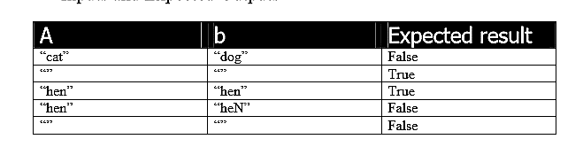
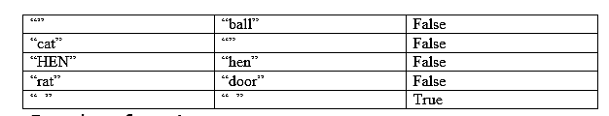
Example

Slide 6
Example
bool isStringsEqual(char a[], char b[]) {
bool result;
if (strlen(a) != strlen(b))
{
result = false;
}
else {
for ( int i =0; i < strlen(a); i++)
{
if ( a[i] == b[i] )
{ result = true; }
else
{ result = false; }
}
}
return result;
}

Slide 7
A Strategy for Testing Software
System Testing
Narrow to
Broader scope
Validation Testing
Integration Testing
Unit Testing
Code
Abstract to
concrete
Design
Requirements
System Engineering

Slide 8
Testing Principles
1. All tests should be traceable to customer requirements
The objective of software testing is to find defects. It follows that the most severe defects are those that cause systems to fail to meet their requirements
2. Tests should be planned long before testing begins.
Test planning can begin as soon as the requirements model is complete
3. The Pareto (80-20) principle applies to software testing
80% of all defects found will likely be traced to 20% of modules. These error-prone modules should be isolated and tested thoroughly.

Slide 9
Testing Principles
4. The testing should begin “in the small” and progress toward testing “in the large”.
The first tests planned and executed focus on individual components. As testing progresses, focus shifts to integrated clusters of components.
5. Exhaustive testing is not possible.
It is impossible to execute every combination of paths during testing. It is possible, however, to adequately cover program logic and to ensure that all conditions in the component-level design have been exercised.

Slide 10
Levels of Specifications
There are usually at least three levels of software specification documents in large systems:
Functional specifications (or requirements) give a precise description of the required behavior of the system – what the software should do, not how it should do it – may also describe constraints on how this can be achieved.
Design specifications describe the architecture of the design to implement the functional specification – the components of the software and how they are to relate to one another.
Detailed design specifications describe how each component of the architecture is to be implemented – down to the individual code units.

Slide 11
Types of software Testing

Slide 12
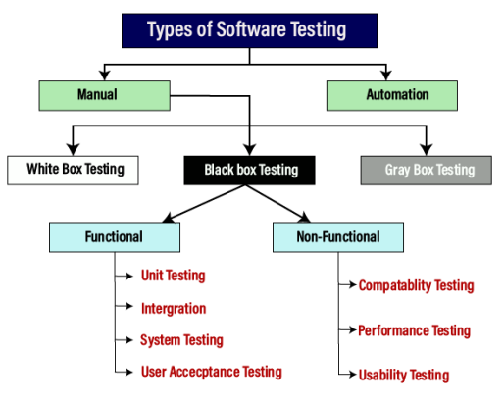
Manual vs Automation
In manual testing (as the name suggests), test cases are executed manually (by a human, that is) without any support from tools or scripts.
But with automated testing, test cases are executed with the assistance of tools, scripts, and software.

Slide 13
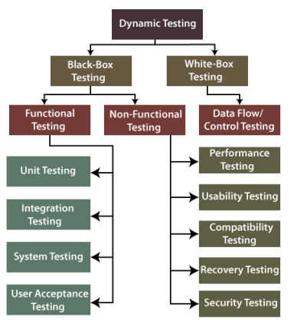
Static vs Dynamic
Static Testing is a type of software testing in which software application is tested without code execution. Manual reviews of code, requirement documents and document design are done in order to find the errors.
The main objective of static testing is to improve the quality of software applications by finding errors in early stages of software development process.

Slide 14
Static Testing
To avoid the errors, we will execute Static testing in the initial stage of development because it is easier to identify the sources of errors, and it can fix easily.
We can do some of the following important activities while performing static testing:
Business requirement review (functional requirement, Use case reviews)
Design review (architecture + design) (non-functional requirements)
The test documentation review

Slide 15
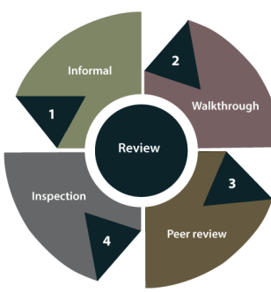
Static Testing
In static testing, reviews can be divided into four different parts, which are as follows:
Informal reviews
In informal review, the document designer place the contents in front of viewers, and everyone gives their view; therefore, bugs are acknowledged in the early stage.
Walkthrough
Generally, the walkthrough review is used to performed by a skilled person or expert to verify the bugs. Therefore, there might not be problem in the development or testing phase.

Slide 16
Static Testing
Peer review
In Peer review, we can check one another's documents to find and resolve the bugs, which is generally done in a team.
Inspection
In review, the inspection is essentially verifying the document by the higher authority, for example, the verification of SRS [software requirement specifications] document.

Slide 17
Black box Testing

Slide 18
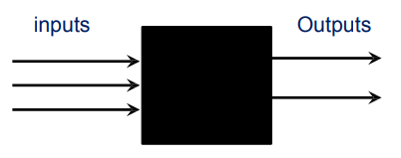
Black Box Testing
A strategy in which testing is based on requirements and specifications.
In this method, tester selects a function and gives input value to examine its functionality, and checks whether the function is giving expected output or not. If the function produces correct output, then it is passed in testing, otherwise failed.
No knowledge of internal design or code required.
Tests are data driven.

Slide 19
Black box Testing techniques

Slide 20
Black Box Testing Techniques
Exhaustive testing
Equivalence class testing (Equivalence Partitioning)
Boundary value analysis
Decision table testing
State-Transition testing

Slide 21
1. Exhaustive testing
Definition: testing with every member of the input value space
Input value space: the set of all possible input values to the program
Consider an application in which a password field that accepts 3 characters, with no consecutive repeating entries. Hence, there are 26 * 26 * 26 input permutations for alphabets only. Including special characters and standard characters, there are much more combinations. So, there are 256 * 256 * 256 input combinations.

Slide 22
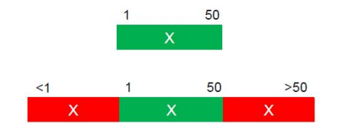
2. Equivalence Class Testing/ Portioning
Equivalence Class Testing is when you have a number of test items (e.g. values) that you want to test but because of cost (time/money) you do not have time to test them all.
Therefore you group the test item into class where all items in each class are suppose to behave exactly the same.
The theory is that you only need to test one of each item to make sure the system works.

Slide 23
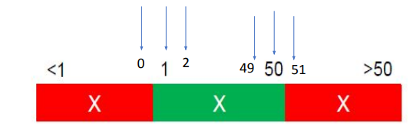
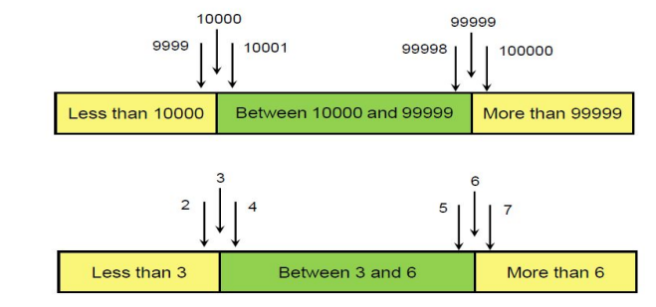
3. Boundary Value Analysis
Maximum Defects occurs on Boundaries
1.Identify the Equivalence Classes and Identify the boundaries of each Equivalence Class.
2.Create test cases for each boundary value by choosing one point on the boundary, one point just below the boundary, and one point just above the boundary.

Slide 24
Why to go with Boundary Value Analysis?
Consider an example where a developer writes code for an amount text field which will accept and transfer values only from 100 to 5000.
The test engineer checks it by entering 99 into the amount text field and then clicks on the transfer button. It will show an error message as 99 is an invalid test case, because the boundary values are already set as 100 and 5000.
Since 99 is less than 100, the text field will not transfer the amount.

Slide 25
4. Decision Table Testing
An tool for capturing certain kinds of system requirements and documenting internal system design.
Record complex business rules that a system must implement.
Also can serve as a guide to creating test cases.

Slide 26
4. Decision Table Testing
Condition
▪ Condition describe the conditions or factors that will affect the decision or policy.
▪ They are listed in the upper section of the decision table.
Action
▪ Action describe, in the form of statements, the possible policy actions or decisions
▪ They are listed in the lower section of the decision table.
Rules
▪ Rules describe which actions are to be taken under a specific combination of conditions.

Slide 27
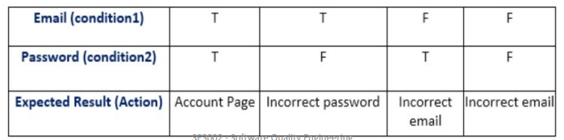
4. Decision Table Testing
Most of us use an email account, and when you want to use an email account, for this you need to enter the email and its associated password.
If both email and password are correctly matched, the user will be directed to the email account's homepage; otherwise, it will come back to the login page with an error message specified with "Incorrect Email" or "Incorrect Password."

Slide 28
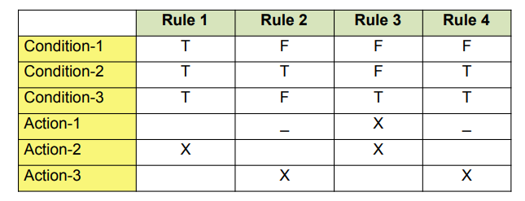
4. Decision Table

Slide 29
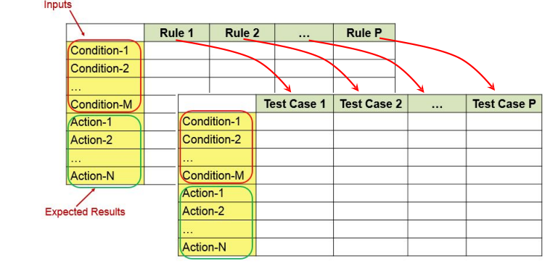
Decision Table Vs Test Case Table
A decision table converted to a test case.

Slide 30
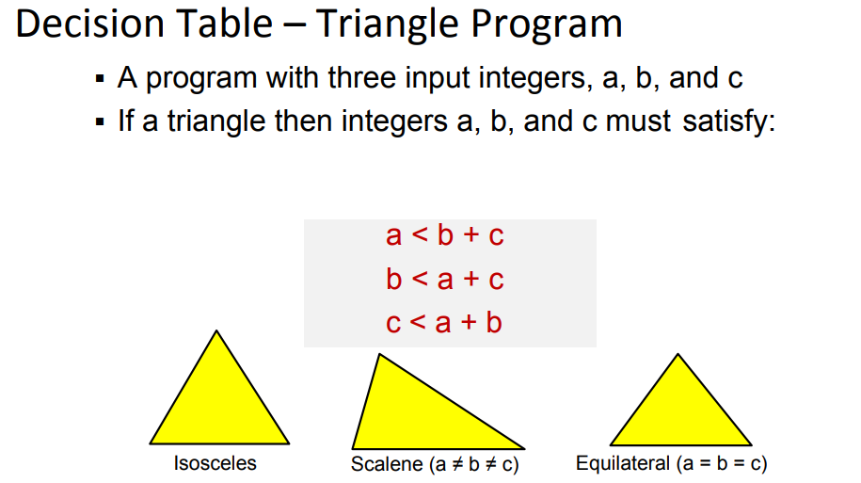

Slide 31
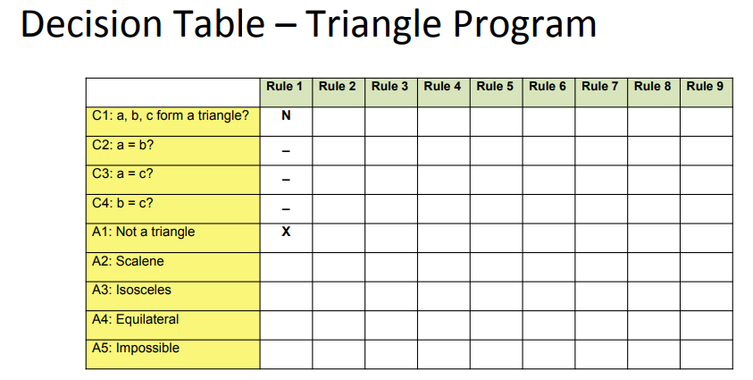

Slide 32
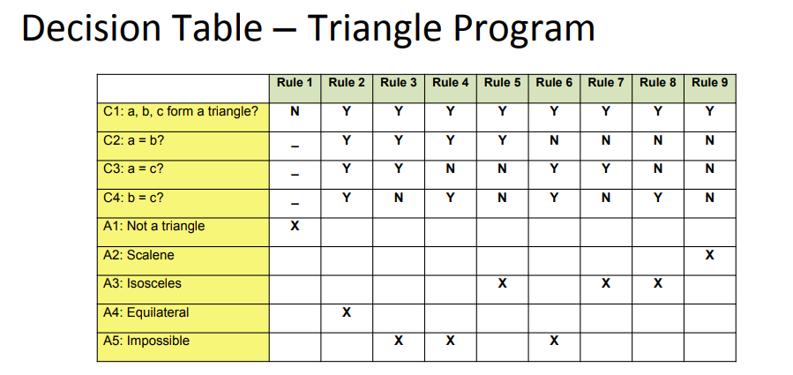

Slide 33
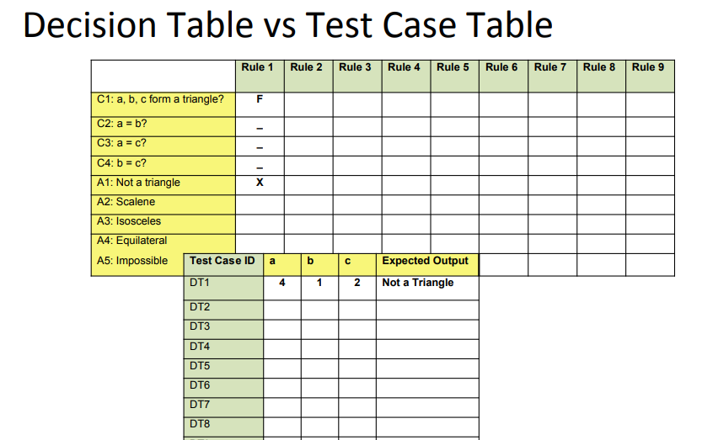

Slide 34
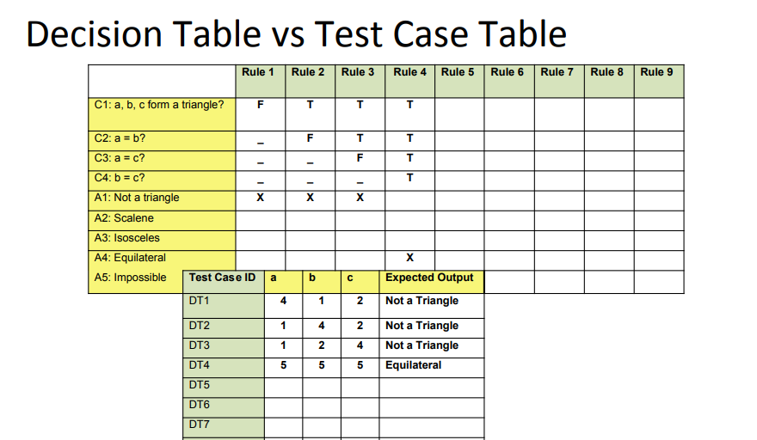

Slide 35
Applicability
Decision table testing can be used whenever the system must implement complex business rules when these rules can be represented as a combination of conditions and when these conditions have discrete actions associated with them.

Slide 36
5. State Transition Testing
State Transition Testing is a black box testing technique in which changes made in input conditions cause state changes or output changes in the Application under Test.
State transition testing helps to analyze behavior of an application for different input conditions.
Testers can provide positive and negative input test values and record the system behavior.

Slide 37
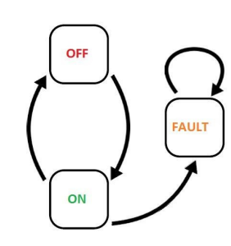
5. State Transition Testing
Models each state a system can exist in
▪ Models each state transition
▪ States
‒ Start State
‒ Input
‒ Output
‒ Finish State

Slide 38

5. State Transition Testing
State ‒
Represented by a circle or oval shape.
A state is a condition in which a system is waiting for one or more events.
States "remember" inputs the system has received in the past and define how the system should respond to subsequent events when they occur.
These events may cause state-transitions and/or initiate actions.

Slide 39
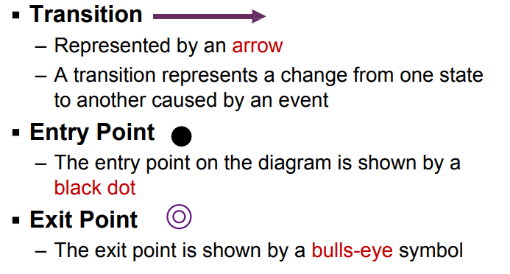
5. State Transition Testing

Slide 40
5. State Transition Testing
Action
An action is an operation initiated because of a state change.
Often these actions cause something to be created that are outputs of the system.
Actions occur on transitions between states

Slide 41
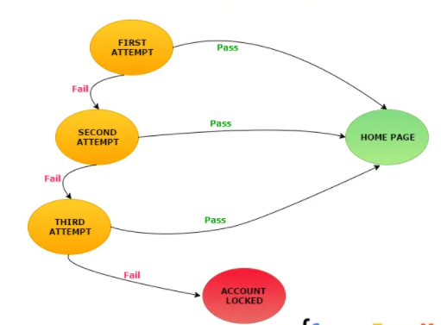
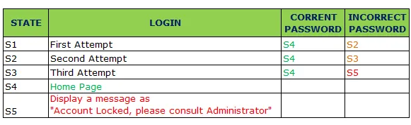

Slide 42
Types of Black box Testing

Slide 43
Types of black box testing
Functional testing
System testing
End-to-end testing
Sanity testing
Regression testing
Acceptance testing
Load testing
Stress testing
Install/uninstall testing
Recovery testing
Compatibility testing
Comparison testing
Alpha testing
Beta testing
Mutation testing

Slide 44
Functional testing
Black box type testing geared to functional requirements of an application.
System testing
Black box type testing that is based on overall requirements specifications; covering all combined parts of the system.
End-to-end testing
Similar to system testing; involves testing of a complete application environment in a situation that mimics real-world use.

Slide 45
Sanity testing
Initial effort to determine if a new software version is performing well enough to accept it for a major testing effort.
Regression testing
Re-testing after fixes or modifications of the software or its environment.
Acceptance testing
Final testing based on specifications of the end-user or customer.

Slide 46
Load testing
Testing an application under heavy loads.
Eg. Testing of a web site under a range of loads to determine, when the system response time degraded or fails.
Stress Testing
Testing under unusually heavy loads, heavy repetition of certain actions or inputs, input of large numerical values, large complex queries to a database etc.
Term often used interchangeably with ‘load’ and ‘performance’ testing.
Performance testing
Testing how well an application complies to performance requirements

Slide 47
Install/uninstall testing
Testing of full, partial or upgrade install/uninstall process.
Recovery testing
Testing how well a system recovers from crashes, HW failures or other problems.
Compatibility testing
Testing how well software performs in a particular HW/SW/OS/NW environment.
Comparison testing
Comparing SW strengths and weakness to competing products.

Slide 48
Alpha testing
Testing done when development is nearing completion; minor design changes may still be made as a result of such testing.
Beta-testing
Testing when development and testing are essentially completed and final bugs and problems need to be found before release.
Mutation testing
To determining if a set of test data or test cases is useful, by deliberately introducing various bugs.
Re-testing with the original test data/cases to determine if the bugs are detected.

Slide 49
HAVE A GOOD DAY!

